Slide 1




Course name: engineering mathematics-iII
B.TECH Second YEAR
Academic YEAR: 2020-2021
Course code : ma 2101
lecture series no : 5
Credits : 3
Mode of delivery : online (Power point presentation)
Faculty : Dr. Pooja Sharma
Email-id : pooja.sharma@jaipur.manipal.edu
PROPOSED DATE OF DELIVERY: 24 August 2020

Slide 2

Session outcome
“Understanding of Lattices and the properties, Understand the concept of different lattices ”

Slide 3
Lattices
A lattice is a partially ordered set (L, ≤ ) in which every pair of elements of L has a least upper bound and a greatest lower bound. In other words, the poset (L, ≤ ) is a lattice if for every a, b ϵ L, sup{a, b} and inf{a, b} exist in L. We denote
sup{a, b} by a ˅ b and call it the join of a and b.
Inf{a, b} by a ˄ b and call it the meet of a and b
Other notations
a+ b for sup {a, b} i.e. a + b for a ˅ b
a. b for inf{a, b} i.e. a .b for a ˄ b

Slide 4
Exercise: Is the poset (Z+, |) a lattice?
Let a and b be two positive integers. The least upper bound and greatest lower bound of these two integers are the least common multiple and the greatest common divisor of these integers, respectively. So, the given poset is a lattice.
Exercise: Determine whether (P(S) ⊆) is a lattice, where P(S) is the power set of non- empty set S.
Let A and B be two subsets of S. The least upper bound and the greatest lower bound of A and B are A U B and A Ո B respectively. Hence, (P(S) ⊆) is a lattice.

Slide 5
Exercise: Determine whether the posets represented by the following Hasse diagrams are lattices:
The posets represented by the Hasse diagrams in (a) and (c) are lattices where that represented by (b) is not.

Slide 6
Exercise: Determine whether the posets represented by the following Hasse diagrams are lattices:

Slide 7

Theorem: In a lattice (L, ≤ ) ,
1. For any a,b ϵ L
and
2.

Slide 8
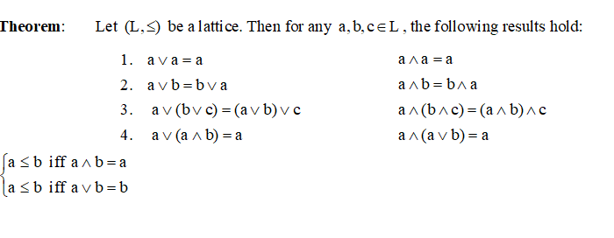

Slide 9
Thanks

